Slide 1
Android Programming Practicals
By
Vandana K

Slide 2
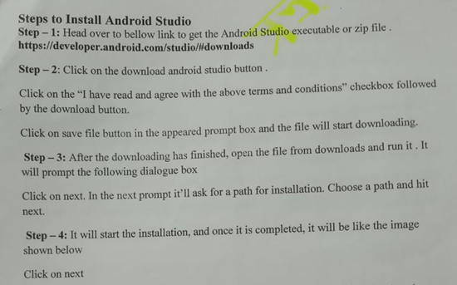

Slide 3
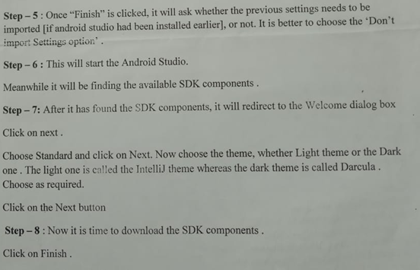

Slide 4
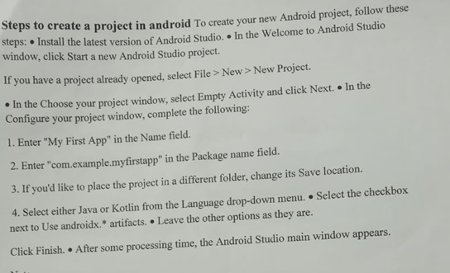

Slide 5
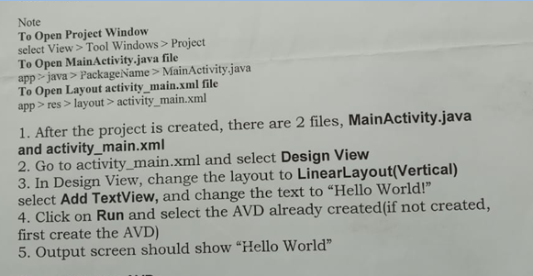

Slide 6
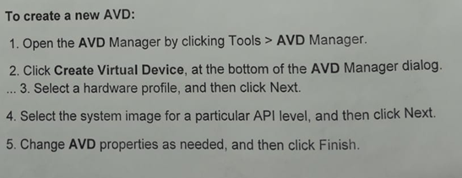

Slide 7
To Open Project Window
select View > Tool Windows > Project
To Open MainActivity.java file
app > java > PackageName > MainActivity.java
To Open Layout activity_main.xml file
app > res > layout > activity_main.xml

Slide 8
After the project is created, there are 2 files, MainActivity.java and activity_main.xml
2. Go to activity_main.xml and select Design View
3. In Design View, change the layout to LinearLayout(Vertical) select Add TextView, and change the text to “Hello World!”
4. Click on Run and select the AVD already created(if not created, first create the AVD)
5. Output screen should show “Hello World”

Slide 9
To create a new AVD:
1. Open the AVD Manager by clicking Tools > AVD Manager.
2. Click Create Virtual Device, at the bottom of the AVD Manager dialog. ...
3. Select a hardware profile, and then click Next.
4. Select the system image for a particular API level, and then click Next.
5. Change AVD properties as needed, and then click Finish.
How to open app in mobile:
-Click 7 times on settings of device on mobile
it will add developer mode then enable developer mode.
-send .apk file to your phone via whatsapp
and install .apk file
-it will create icon of your .apk
and see the output

Slide 10
Intent
Intent is to perform an action.
It is mostly used to start activity, send broadcast receiver, start services and send message between two activities.
There are two intents available in android as
Implicit Intents and
Explicit Intents.
Explicit Intent − It going to connect the internal world of an application such as start activity or send data between two activities.
To start new activity we have to create Intent object and pass source activity and destination activity as shown below −
Intent send = new Intent(MainActivity.this, SecondActivity.class);
startActivity(send);
And we should declare about second activity in Manifest.xml file or else it going to show run time exception.
sample declaration is as shown below.
<activity android:name = ".SecondActivity"></activity>

Slide 11
Implicit Intents − It going to connect with outside application such as call, mail, phone,see any website ..etc.
In implicit intent we have to pass an action using setAction() as shown below example.
Intent i = new Intent();i.setAction(Intent.ACTION_VIEW);
i.setData(Uri.parse("www.tutorialspoint.com"));startActivity(i);
Here, we are giving action as view. so it going to show something which we have given in setData method.
setData() - This method is only to specifies a URI.
setType()- This method specifies a MIME type.
setDataAndType()- This method i specifies both a URI and a MIME type.

Slide 12
Events
Events are a useful way to collect data about a user's interaction with interactive components of Applications.
Like button presses or screen touch etc.
The Android framework maintains an event queue as first-in, first-out (FIFO) basis.
You can capture these events in your program and take appropriate action as per requirements.

Slide 13
Events
There are following three concepts related to Android Event Management −
Event Listeners − An event listener is an interface in the View class that contains a single callback method. These methods will be called by the Android framework when the View to which the listener has been registered is triggered by user interaction with the item in the UI.
Event Listeners Registration − Event Registration is the process by which an Event Handler gets registered with an Event Listener so that the handler is called when the Event Listener fires the event.
Event Handlers − When an event happens and we have registered an event listener for the event, the event listener calls the Event Handlers, which is the method that actually handles the event.

Slide 14
Event Listeners & Event Handlers
Event Handler | Event Listener & Description
onClick() | OnClickListener() This is called when the user either clicks or touches or focuses upon any widget like button, text, image etc. You will use onClick() event handler to handle such event.
onLongClick() | OnLongClickListener() This is called when the user either clicks or touches or focuses upon any widget like button, text, image etc. for one or more seconds. You will use onLongClick() event handler to handle such event.
onFocusChange() | OnFocusChangeListener() This is called when the widget looses its focus ie. user goes away from the view item. You will use onFocusChange() event handler to handle such event.
onKey() | OnFocusChangeListener() This is called when the user is focused on the item and presses or releases a hardware key on the device. You will use onKey() event handler to handle such event.
onTouch() | OnTouchListener() This is called when the user presses the key, releases the key, or any movement gesture on the screen. You will use onTouch() event handler to handle such event.
onMenuItemClick() | OnMenuItemClickListener() This is called when the user selects a menu item. You will use onMenuItemClick() event handler to handle such event.
onCreateContextMenu() | onCreateContextMenuItemListener() This is called when the context menu is being built(as the result of a sustained "long click)

Slide 15
Events
There are many more event listeners available as a part of View class like OnHoverListener, OnDragListener etc which may be needed for your application.
So It is recommend to refer official documentation for Android application development in case you are going to develop a sophisticated apps.

Slide 16
Event Registration
Event Registration is the process by which an Event Handler gets registered with an Event Listener so that the handler is called when the Event Listener fires the event.
Though there are several tricky ways to register your event listener for any event, but here listed down only top 3 ways, out of which you can use any of them based on the situation.
Using an Anonymous Inner Class
Activity class implements the Listener interface.
Using Layout file activity_main.xml to specify event handler directly.

Slide 17
Below section will provide you detailed examples on all the three scenarios −
Touch Mode
Users can interact with their devices by using hardware keys or buttons or touching the screen.Touching the screen puts the device into touch mode. The user can then interact with it by touching the on-screen virtual buttons, images, etc.You can check if the device is in touch mode by calling the View class’s isInTouchMode() method.
Focus
A view or widget is usually highlighted or displays a flashing cursor when it’s in focus. This indicates that it’s ready to accept input from the user.
isFocusable() − it returns true or false
isFocusableInTouchMode() − checks to see if the view is focusable in touch mode. (A view may be focusable when using a hardware key but not when the device is in touch mode)
android:foucsUp="@=id/button_l"

Slide 18
onTouchEvent()
public boolean onTouchEvent(motionEvent event){
switch(event.getAction()){
case TOUCH_DOWN:
Toast.makeText(this,"you have clicked down Touch button",Toast.LENTH_LONG).show();
break();
case TOUCH_UP:
Toast.makeText(this,"you have clicked up touch button",Toast.LENTH_LONG).show();
break;
case TOUCH_MOVE:
Toast.makeText(this,"you have clicked move touch button"Toast.LENTH_LONG).show();
break;
}
return super.onTouchEvent(event) ;

Slide 19
Thank you

